Slide 1

Chapter 7
(Some Function About I/O)
&&
(Project Introduction)
报告人：姚杰

Slide 2
Some Useful （Function || Skills || Tips）
int printf（char *format ,arg1,arg2,……）
%? ：%3？: 97 ---- _97 9876 ---- 9876
%3-？: 多个？左对齐
%05d : 85 ---- 00085
%f ：%9.2f ：输出场宽为9的浮点数, 其中小 数位为2, 整数位为6, 小数点占一位, 不够9位右对齐.

Slide 3
Some Useful （Function || Skills || Tips）
int scanf(char *format ,arg1,arg2,……);
Must Be Pointer
int strcmp(const char *s1, const char *s2);
char *strcpy(char *dest, const char *src);

Slide 4
Some Useful （Function || Skills || Tips）
isspace(): checks for white-space characters. these are: ①space
②form-feed ('\f')
③newline ('\n')
④carriage return ('\r')！
⑤horizontal tab ('\t')
⑥vertical tab ('\v')
Realloc():NULL || New Pointer || Old Pointer

Slide 5
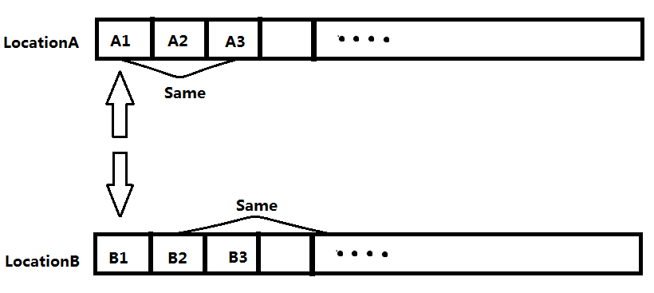
Project_One_v1.0
1.Read Data_A&Data_B
2.Sort_by_key_columns
3.Compare&print

Slide 6
Project_One_v2.0
1.Read Data_A
2.Build Trie Tree for Every Column
By its key string
3.Read Data_B by row
Find it in Every Trie Tree.
Tips: Same Data in Data_A --- Link List in Leaves nodes(Set)

Slide 7
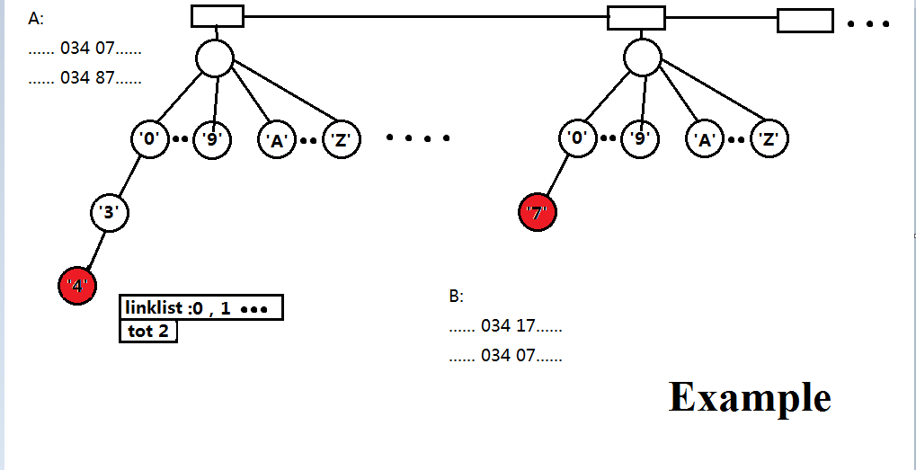

Slide 8
Thanks !

